Slide 1
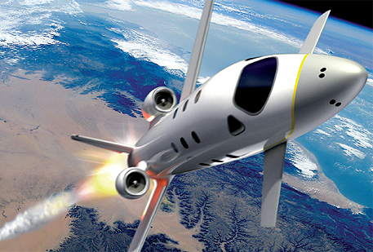

FDIR Spacecraft fault protection system
Project 1
Part 1
Euro Team
Alauzet Pierre, Ahvenniemi Mikko,
Colin Julien, Starck Benoit
CS554 - Design for Software & Systems

Slide 2
Table of ContentS
Background
Functionnal requirements
Non-functionnal requirements
Use-case model

Slide 3
Background
Background
Functionnal requirements
Non-functionnal requirements
Use-case model
Fault
Detected when monitored values are out-of-tolerance
Fault protection system (FDIR)
Act when the spacecraft is going through an error or a fault
FDIR is a layered system. If a lower layer cannot resolve an issue it’s forwarded to an upper layer. If the Issue cannot be resolved by the system. It’s escalated to manual control.
Automatic system
Spaceship crew and flight control can manually control the system

Slide 4
Requirements
Background
Functionnal requirements
Non-functionnal requirements
Use-case model
Global Requirements :
Guarantee the completion of any time critical activities of the spaceship
Keep the control of the spacecraft with safety, observability & commandability

Slide 5
Requirements (cont.)
Background
Functionnal requirements
Non-functionnal requirements
Use-case model
Fault Recovery :
Analyse & locate the fault
2 solutions
Recover the data by doing a backup
Restart the bugging software

Slide 6
ReQUIREMENTS (cont.)
Background
Functionnal requirements
Non-functionnal requirements
Use-case model
Safing response in the case of hazardous conditions :
Isolate the problem
Unmanned spacecraft :
Shutdown all non-critical functions
Manned spacecraft:
Crew Intervention

Slide 7
NON-Functional REQUIREMENTS
Background
Functionnal requirements
Non-functionnal requirements
Use-case model
Testability
The system and its parts have to be able to be tested through inspections, simulations and analyses before on-board installation
Reliability
The system must be reliable in all operating conditions. System failure could lead to loss of human life.
Availability
The system must not lock or stall when processing data. It must work asynchronously.

Slide 8
Non-functional requirements
Background
Functionnal requirements
Non-functionnal requirements
Use-case model
Resilience
The system must be able to maintain an acceptable level of service in spite failures in parts of the FDRI system.
Response time
The system must respond in timely manner so that problematic systems can be shut down before any damage is done.
Documentation
Technical and software documentation has to be accurate so that the spacecraft crew and flight control know how to administer the system and perform actions through it.

Slide 9
Use case diagram explaNATIONS
Background
Functionnal requirements
Non-functionnal requirements
Use-case model
Most of the time FDRI works automatically. However, spaceship crew and flight control can manually control the system.
These interactions are represented in the following use case diagram.

Slide 10
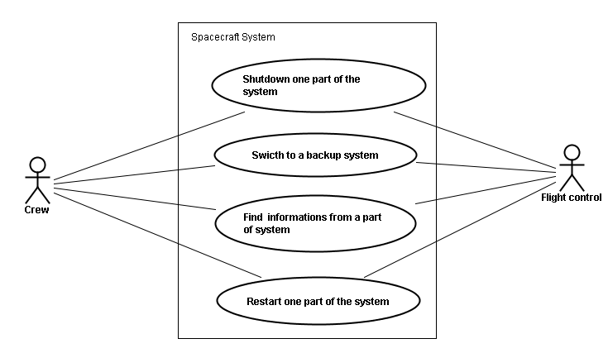
Use case DIAGRAM
Background
Functionnal requirements
Non-functionnal requirements
Use-case model

Slide 11
Use CASES Descriptions
Background
Functionnal requirements
Non-functionnal requirements
Use-case model
Shutdown one part of the system:
Context of use : a part of the system is failed, we want to shutdown it
Actors : Crew / Flight control
Pre-condition: none
Post-condition: the part of the system is shutdown
Guaranty in case of success : any actions could not be done to this part
Guaranty in case of failure : the system turns on

Slide 12
Use CASES Descriptions (cont.)
Background
Functionnal requirements
Non-functionnal requirements
Use-case model
Restart one part of the system:
Context of use : a part of the system is shutdown, we want to restart it
Actors : Crew / Flight control
Pre-condition: the part is shutdown
Post-condition: the part is switched on
Guaranty in case of success : Any action could be done after reboot
Guaranty in case of failure : the system is off yet

Slide 13
Use CASES Descriptions (cont.)
Background
Functionnal requirements
Non-functionnal requirements
Use-case model
Switch to backup system:
Context of use : the current system is corrupted
Actors : Crew / Flight control
Pre-condition: none
Post-condition: the faulty system is switched to a spare system
Guaranty in case of success : the system is not corrupted yet
Guaranty in case of failure : none

Slide 14
Use CASES Descriptions (cont.)
Background
Functionnal requirements
Non-functionnal requirements
Use-case model
Find information about a part of the system:
Context of use : the crew wants to know some information about a part of the system
Actors : Crew / Flight control
Pre-condition: none
Post-condition: the crew receives the information
Guaranty in case of success : we have the information
Guaranty in case of failure : we don't have the information

Slide 15
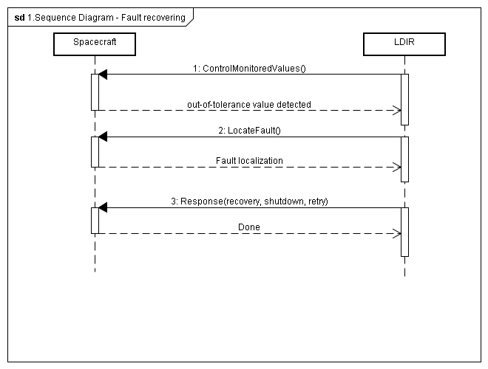
Sequence diagram
Background
Functionnal requirements
Non-functionnal requirements
Use-case model
Fault recovering

Slide 17
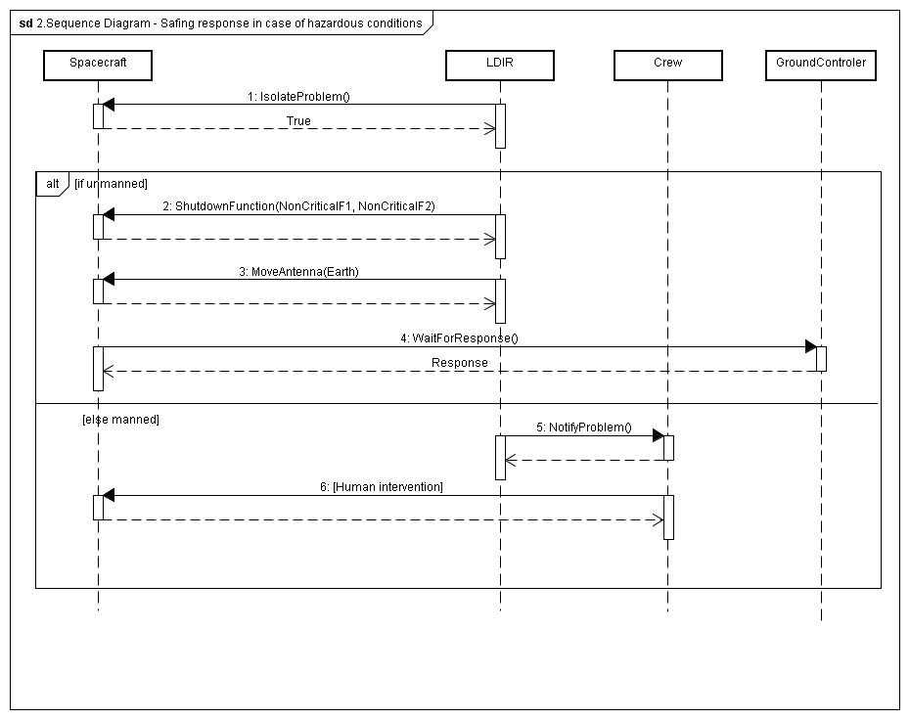
Sequence diagram (cont.)
Background
Functionnal requirements
Non-functionnal requirements
Use-case model
Safing response in case of hazardous condition

Slide 19
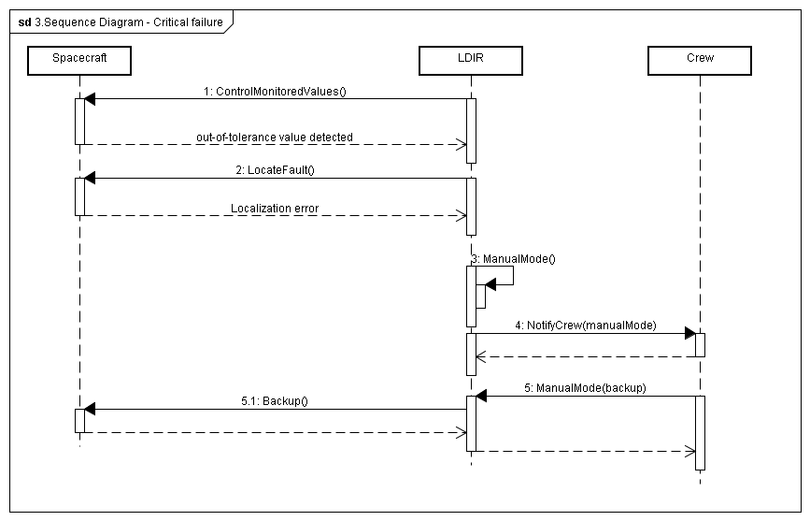
Sequence diagram (cont.)
Background
Functionnal requirements
Non-functionnal requirements
Use-case model
Critical failure

Slide 21
FDIR Spacecraft fault protection system
Project 1
Part 1
Euro Team
Alauzet Pierre, Ahvenniemi Mikko,
Colin Julien, Starck Benoit
CS554 - Design for Software & Systems

Slide 22
references
[Eas98] Steve Easterbrook, and et al., “Experiences Using Lightweight Formal Methods for Requirements Modeling,” IEEE Transactions on Software Engineering, Vol. 24, No. 1, January 1998.

